Slide 1
Security Engineering 101 Ethical Hacking
Mrinal Wahal
IIT Madras, Research Park

Slide 2
TOPIC
Foot printing
scanning
Enumeration
System hacking & password
Phishing
Cryptography
Steganography
proxy
Ip
Malware & viruses
Trojan
Sniffing

Slide 3
Foot printing
Collecting much information about target & victim
website
organization
Network
person

Slide 4
How information store ?
Active information
Internet foot printing

Slide 5
Location
By using Google earth
By using satellite picture
By using Google map

Slide 6
Information about website
www.yougetsignal.com
Domain name
IP Address
Place
Server name
Network block
TCP & UDP service

Slide 7
Information about people
Pipl.com
Intelius.com
Bestpeoplesearch.com
Anywho.com
Peoplefinder.com
Webextrator.com
Binarypool.com
Robtex.com

Slide 8
Search engine machine
Google.com
Bing search bar
Yahoo search bar
Facebook
Twitter

Slide 9
How to protect yourself
Don’t register in any website
Don’t come with your real name and identity to internet
Don’t trust anyone in internet
Don’t post your photo & video in any website
Hide your IP Address
Hid your MAC Address
Don’t use public computer
Don’t use cyber cafe

Slide 10
Scanning
IP scan
Port scan
Vulnerability
networking

Slide 11
IP Address you should not ping & scan
GOVT IP ADDRESSES
Army Information Systems Center
Defense Information Systems Agency
Royal Signals and Radar Establishment
NASA Ames Research Center
NASA Lewis Network Control Center
NASA Johnson Space Center
Air Force Academy
Langley Air Force Base

Slide 12
TOOLS
Ping pocket
Angry ip scanner
Solar wind engineer toolset
Nmap
www.angryip.com
www.solarwinds.com

Slide 13
PROTECT
Close all open ports
Firewall
Comodo firewall
Firewall zen alarm
Use vpn
Use proxy

Slide 14
IP & proxy
What is an IP address
What is mac address
What is proxy

Slide 15
IP v4 & ip v6
How to change your ip
Wow to find location by ip
How to trace an email by ip

Slide 16
PROXY
Psiphon
Anonymiser.ru
Anonymous-surfin.com
Hotspot shield
Tor browser

Slide 17
ENUMERATION
What is enumeration
Super scan enumeration
Dnsstuff.com

Slide 18
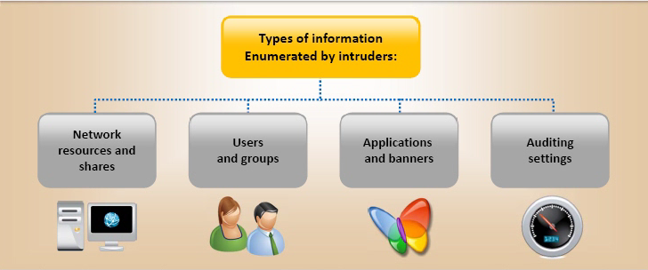

Slide 19
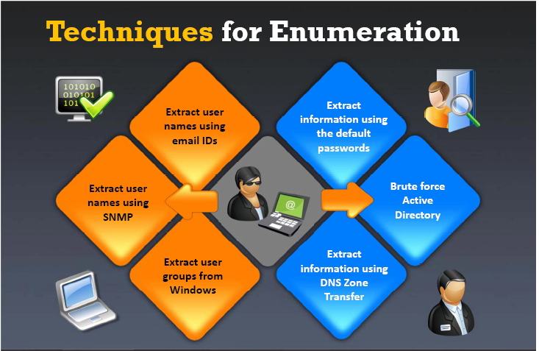

Slide 20
Tools for enumeration
Net bios enumeration
Super scan enumeration
Cmd
Ip network browser tools

Slide 21
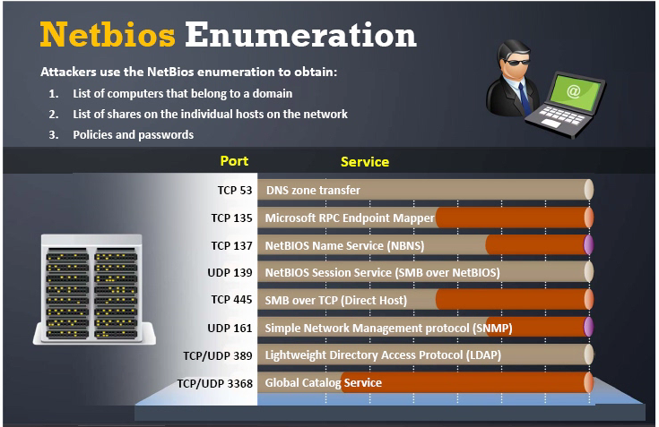

Slide 22
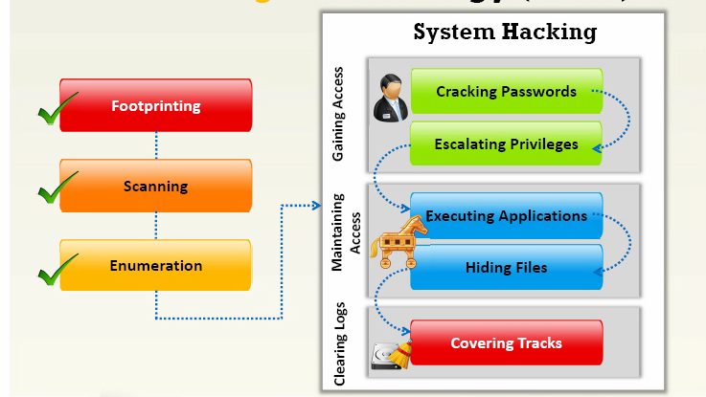

Slide 23
System & Password Hacking
Brut force
Dictionary
Software
Key logger
Live boot
Linux
Hardware

Slide 24
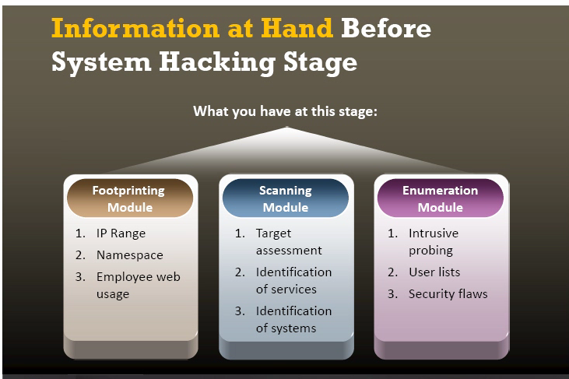

Slide 25
How to attack on password
Default password
Common password
Social engineering
Guess password
Online attack
Software attack

Slide 26
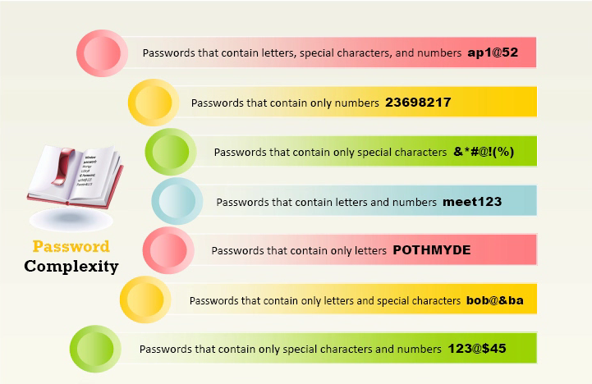

Slide 27
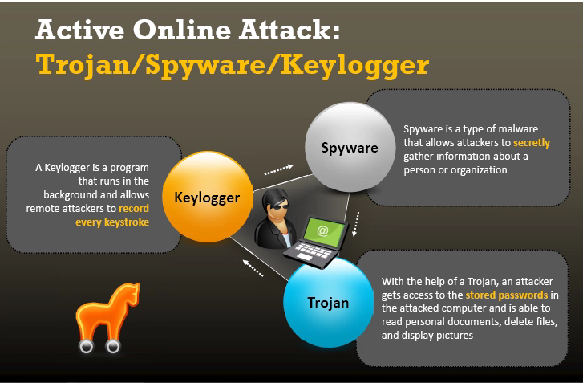

Slide 28
Tools
Cain password cracker
Elcom software
Active @password change

Slide 29
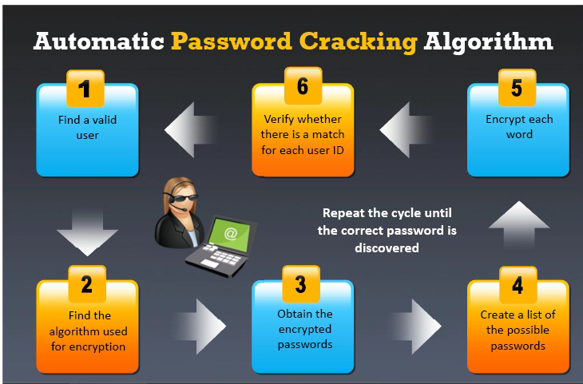

Slide 30
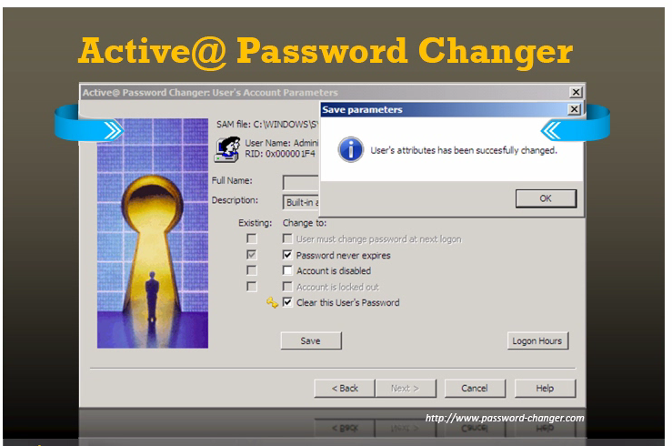

Slide 31
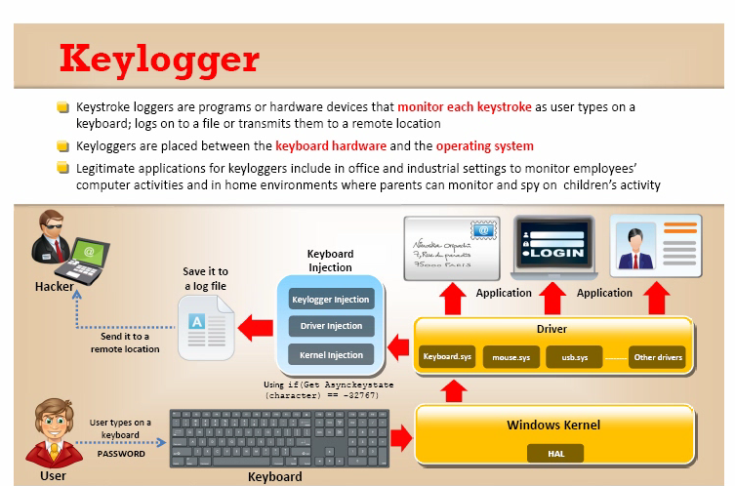

Slide 32
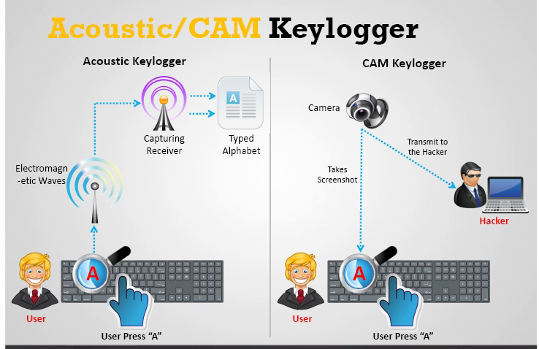

Slide 33
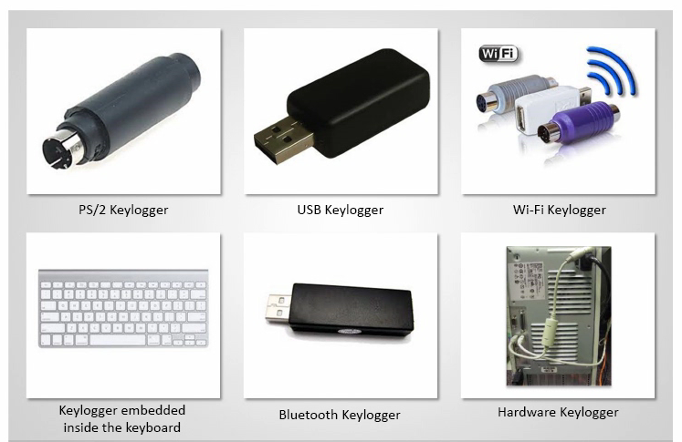

Slide 34
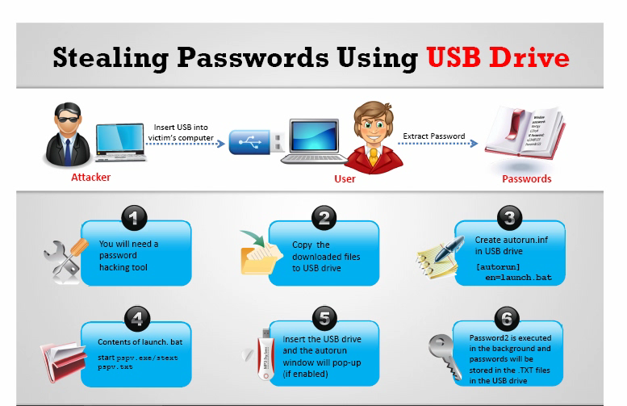

Slide 35
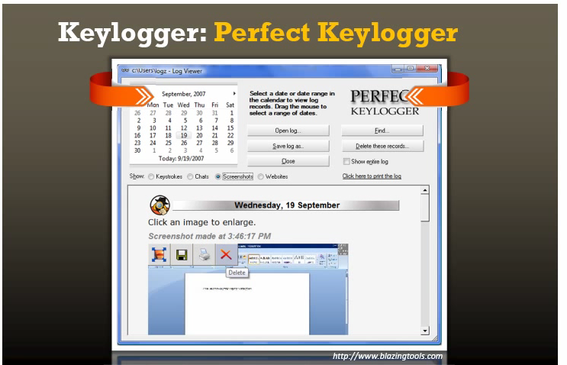

Slide 36
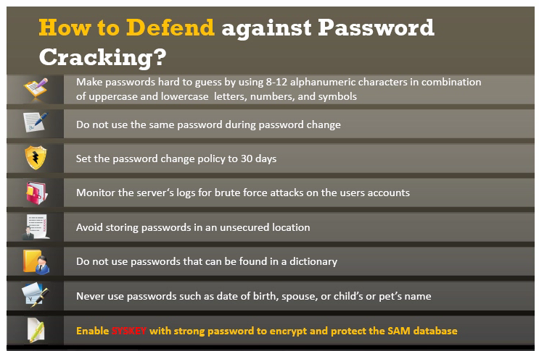

Slide 37
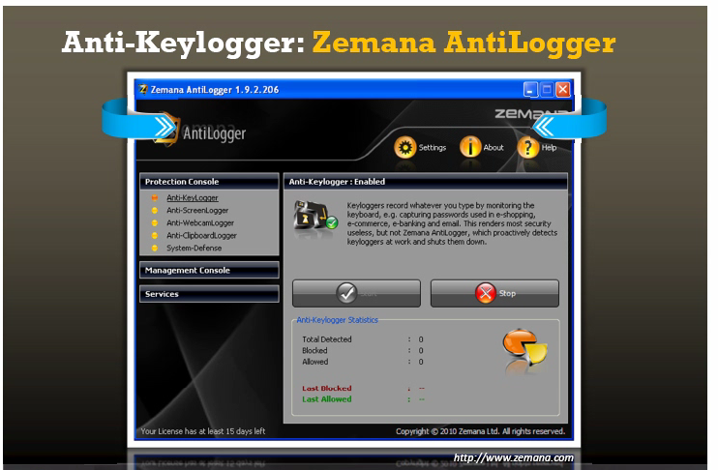

Slide 38
Spy ware
What is spyware and its type
How does it work

Slide 39
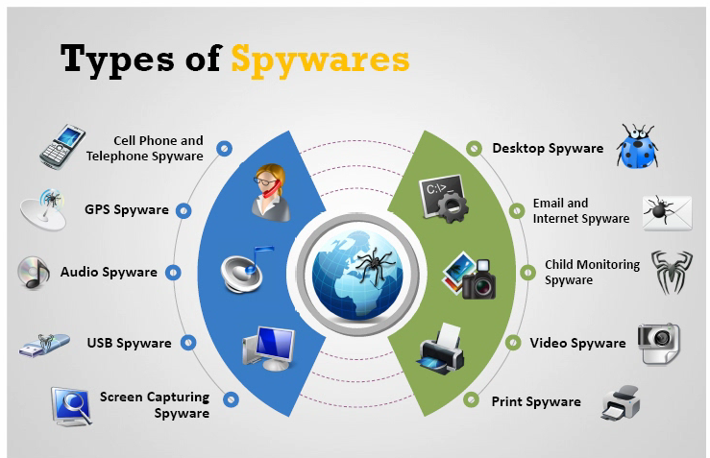

Slide 40
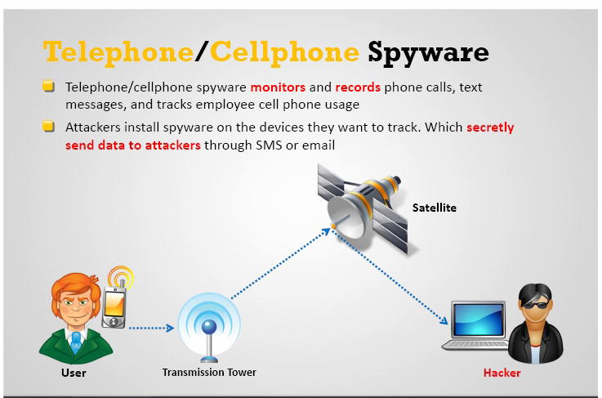

Slide 41
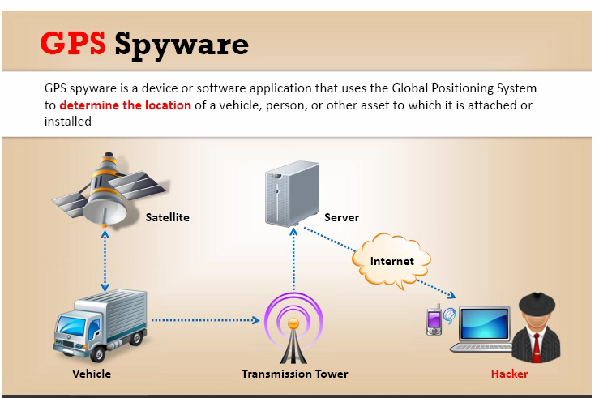

Slide 42
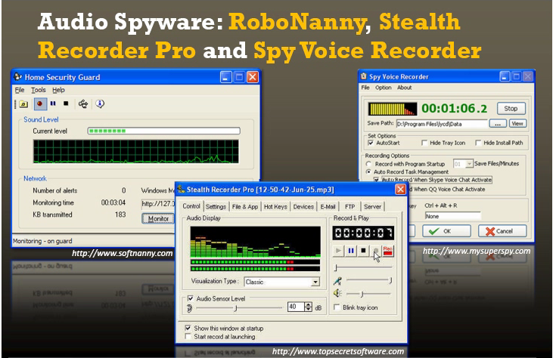

Slide 43
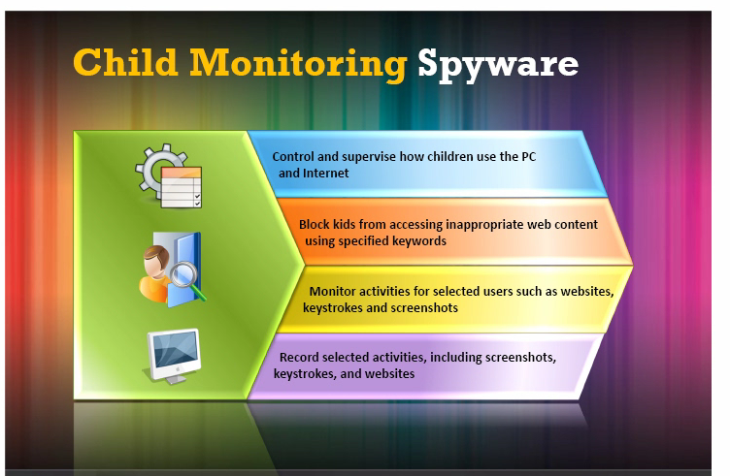

Slide 44
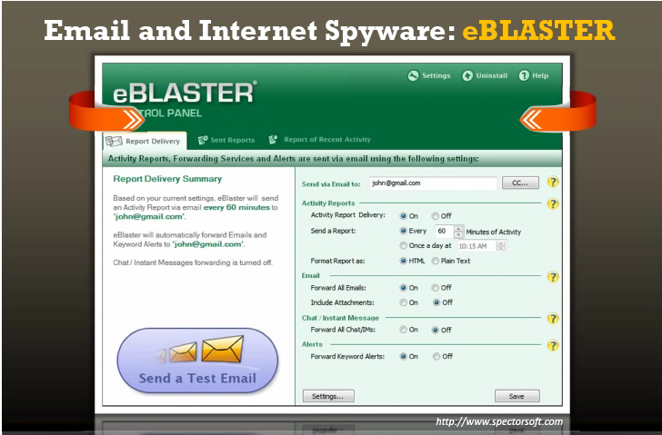

Slide 45
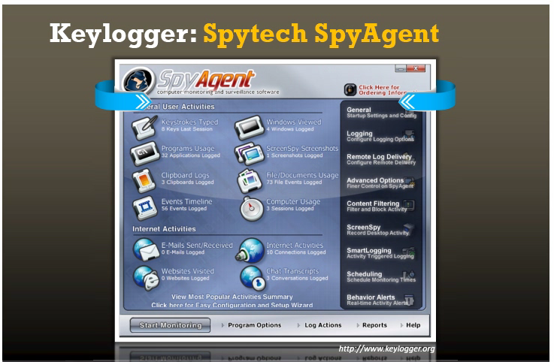

Slide 46
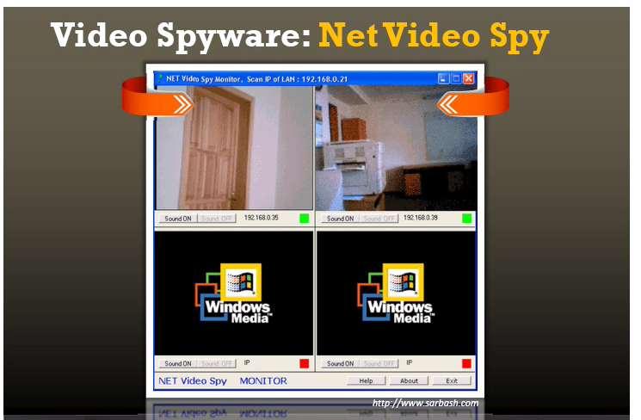

Slide 47
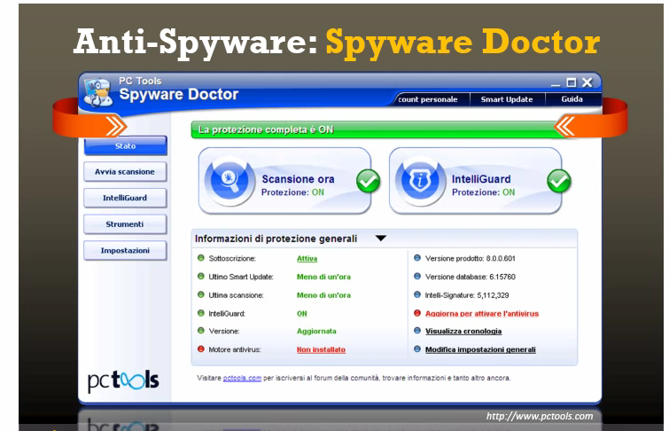

Slide 48
Trojan
What is Trojan
How does it work
How Trojans come to the system

Slide 49
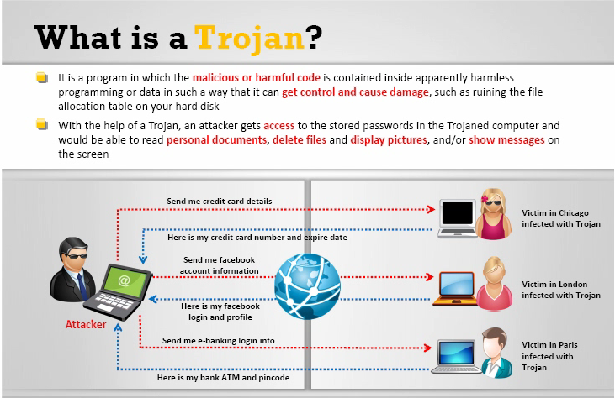

Slide 50
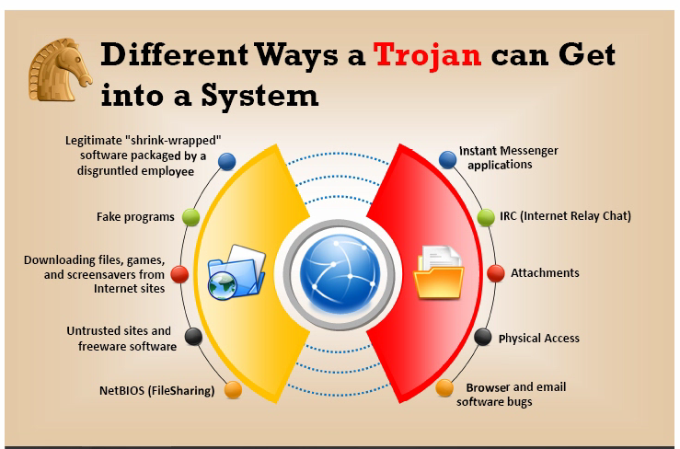

Slide 51
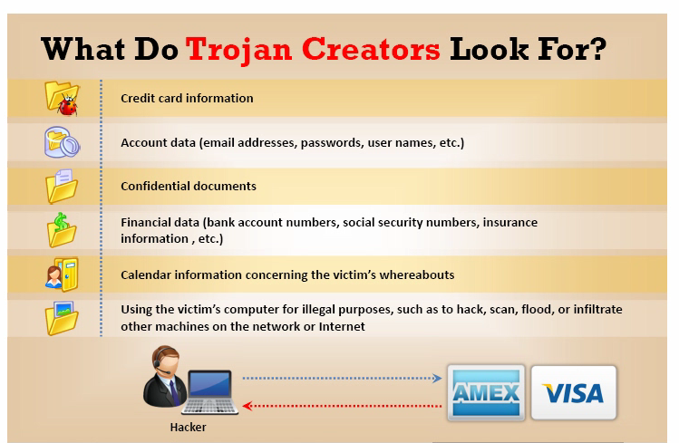

Slide 52
TYPE OF TROJAN
Command shell Trojan
GUI Trojan

Slide 53
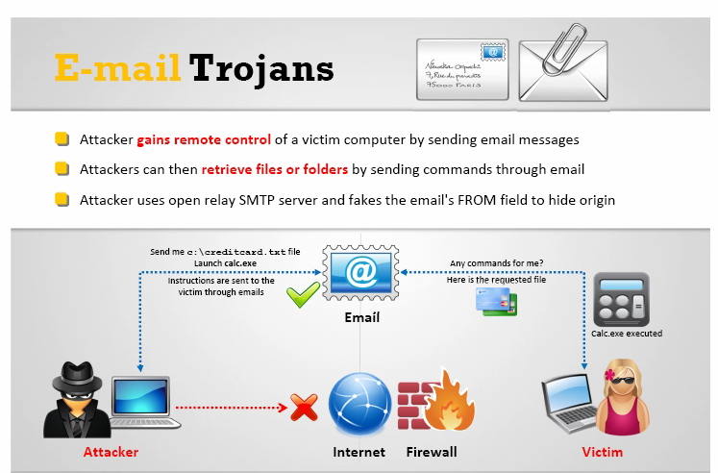

Slide 54
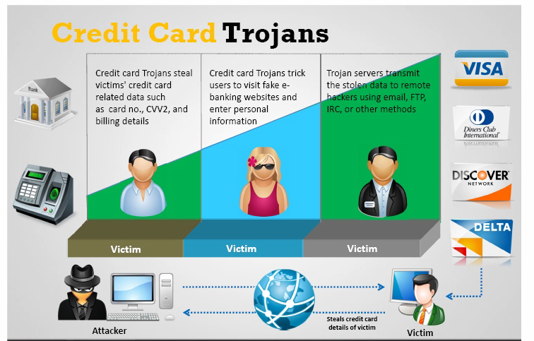

Slide 55
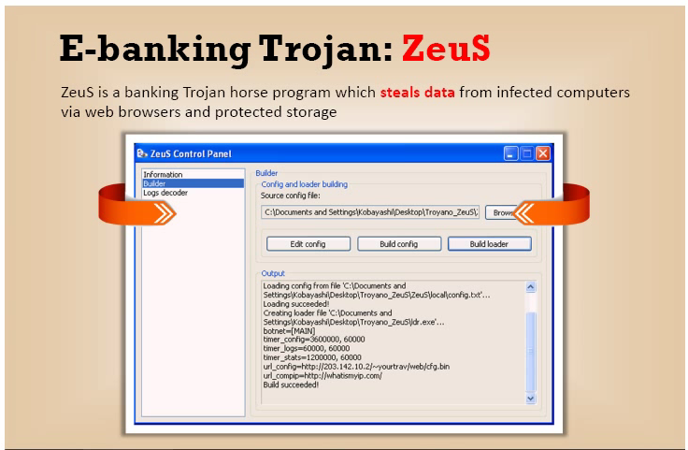

Slide 56
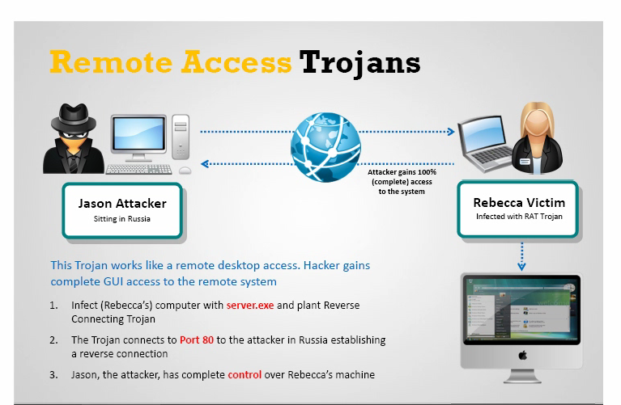

Slide 57
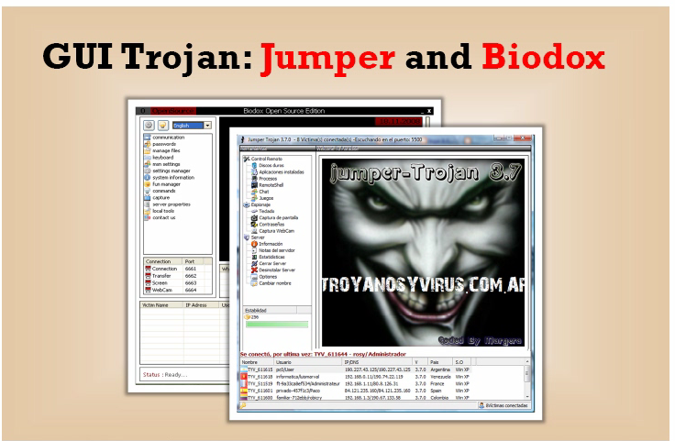

Slide 58
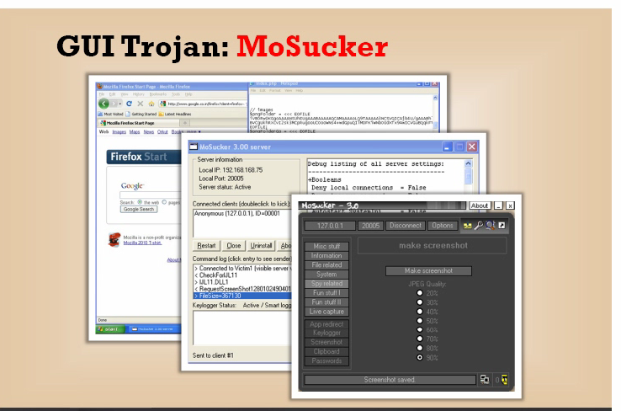

Slide 59
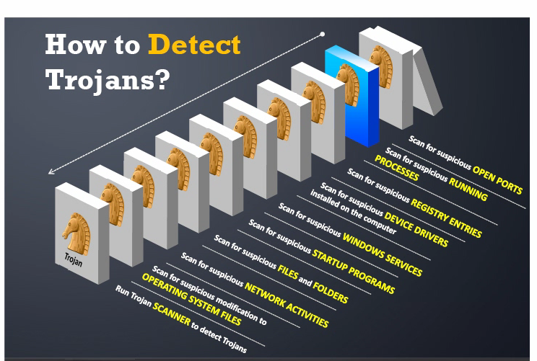

Slide 60
Software for removing Trojan
Net stat –an
Port monitor tool
Process monitor tool
Starter tool
Trojan hunter
TCP view

Slide 61
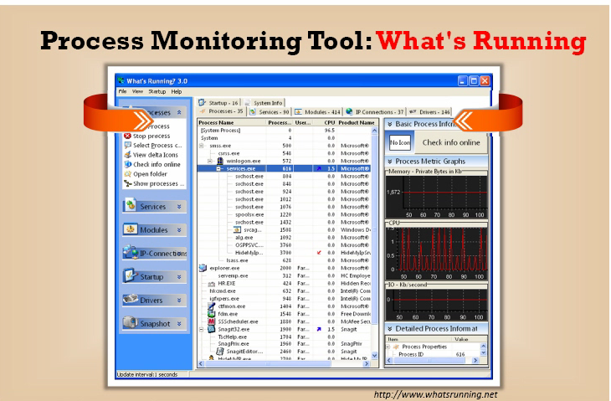

Slide 62
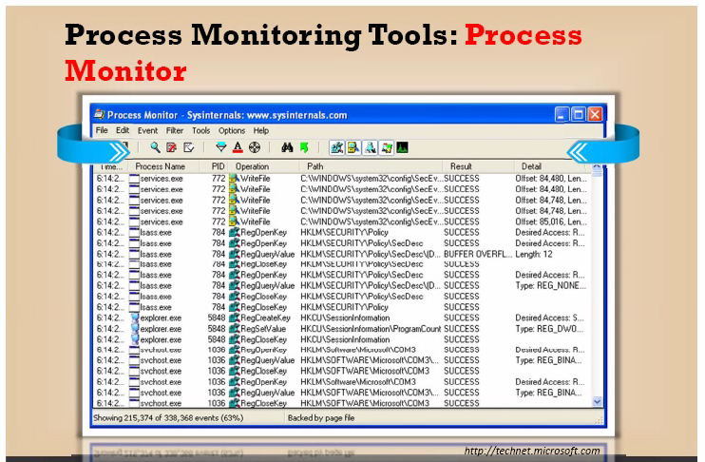

Slide 63
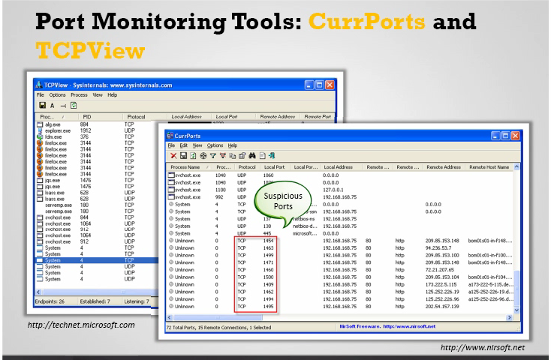

Slide 64
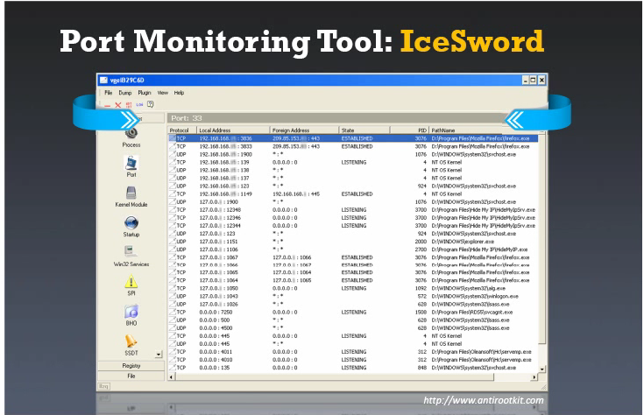

Slide 65
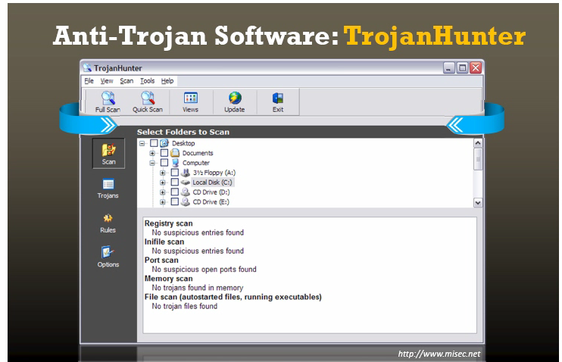

Slide 66
VIRUS AND WARM
What is a virus
Infection of phase
Why people do create virus
How viruses come
How to remove

Slide 67
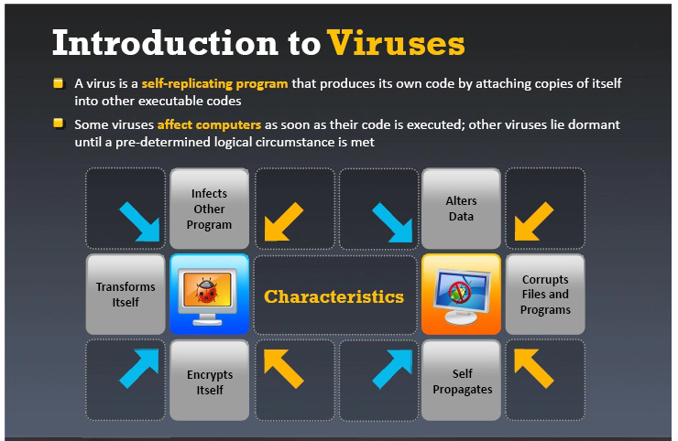

Slide 68
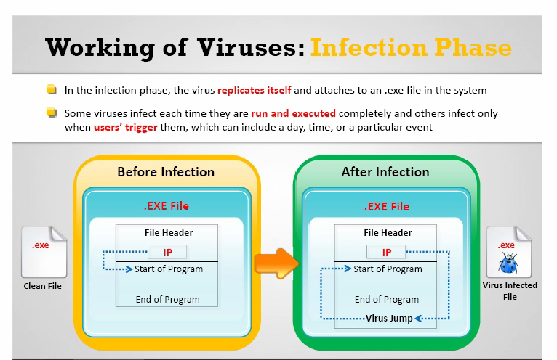

Slide 69
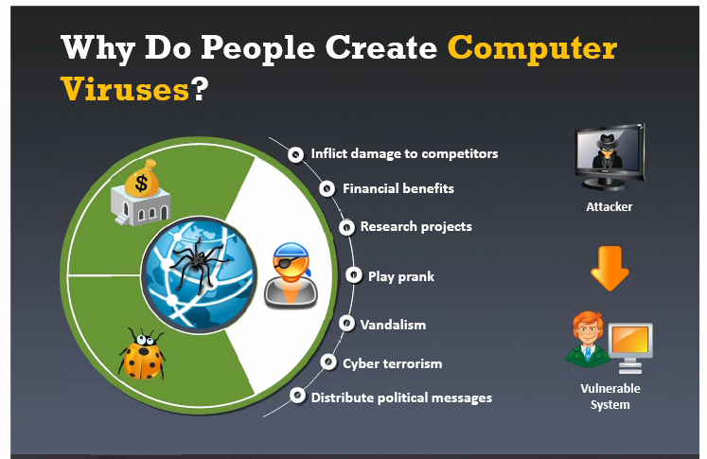

Slide 70
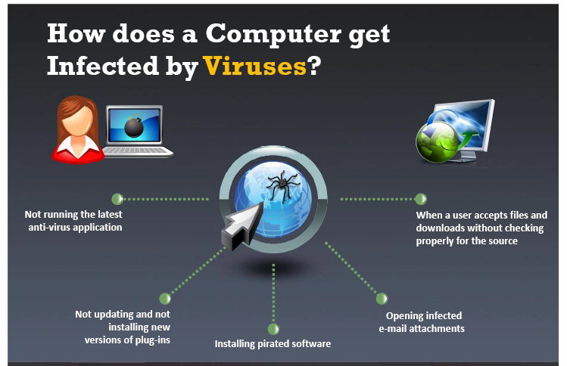

Slide 71
Types of viruses
System or boot sector viruses
File and multimedia viruses
Macro viruses
Cluster viruses
Encryption viruses
File extension viruses

Slide 72
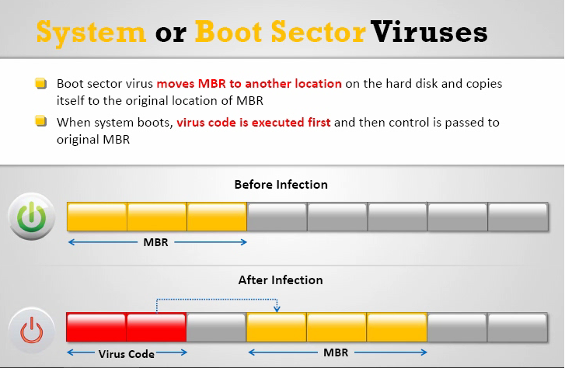

Slide 73
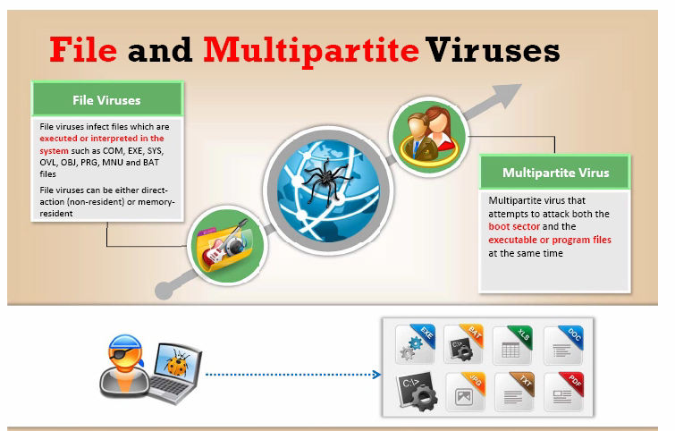

Slide 74
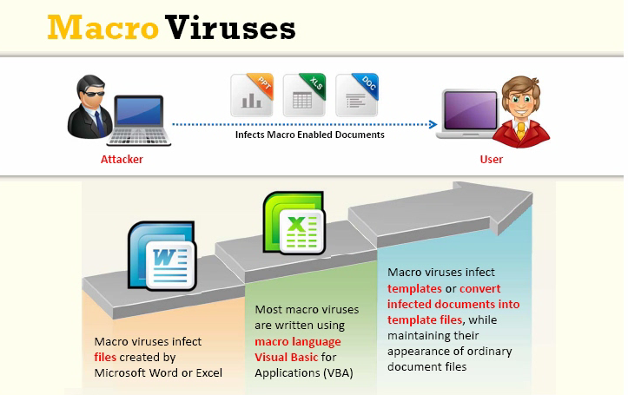

Slide 75
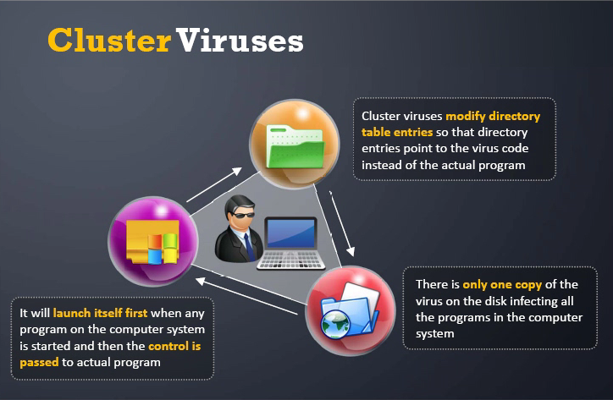

Slide 76
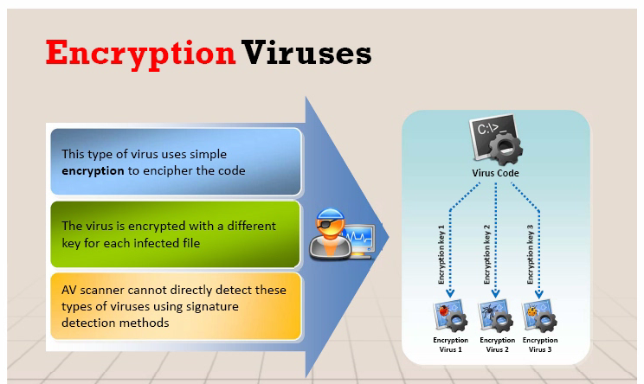

Slide 77
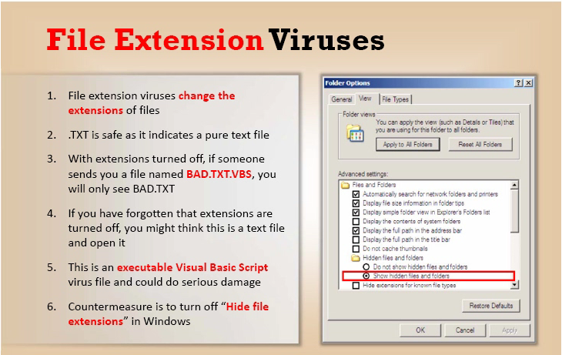

Slide 78
How to remove viruses from computer
Antiviruses sensor
Process monitor tool
Debugging tool
Installing antivirus
Scanning each file
Entry checking
Viruses and warm countermeasures

Slide 79


Slide 80


Slide 81


Slide 82


Slide 83


Slide 84
SNIFFING
How sniffer works
Types of sniffing
Hard ware devices for sniffing
Cain software
Mac sniffing

Slide 85


Slide 86


Slide 87


Slide 88


Slide 89


Slide 90
How to detect
Don’t use physical address
Encrypt your data
Use static IP
Turn off network identification
Use IP v6 instead of IP v4
Sniffing detective technique
Promise scan tool
Promqry UI software

Slide 91


